Slide 1
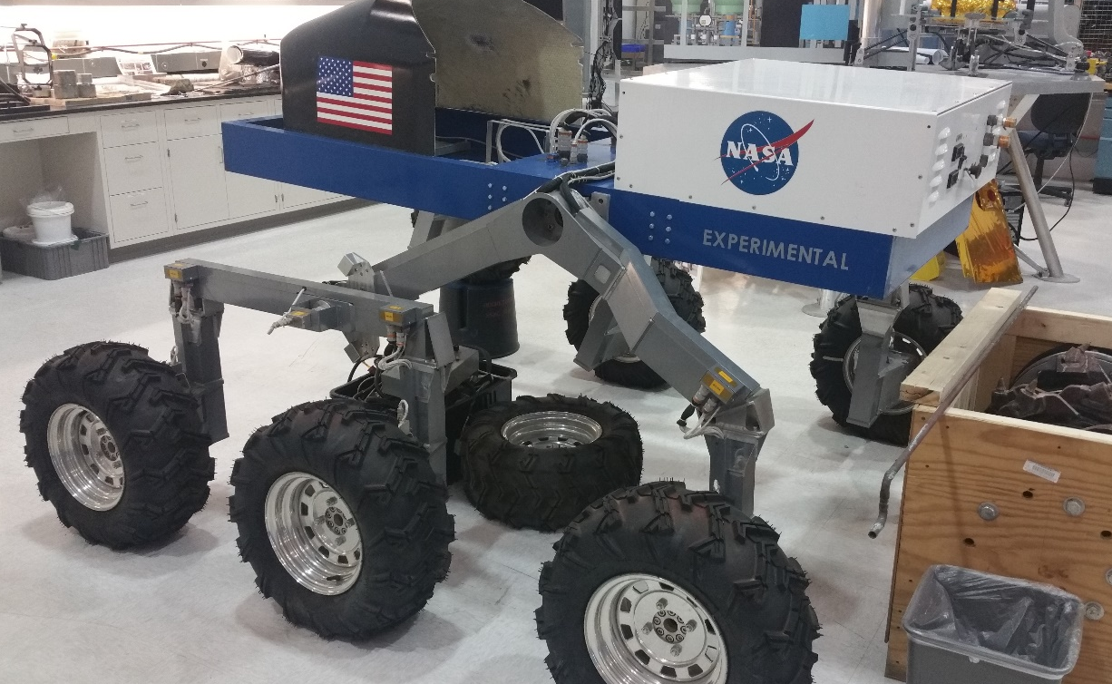
Name Ice Catapult
4 Letter Key H20C
Team ERAU-DB
3 Letter Key ERD
Date 3/18/2018
Data Elements:
Position, Orientation, Battery Level, Payload Mass, Mass
Description:
H20C is a large (~100m), counter-weighted, slotted, swing arm with a ramp, attached to a very large disk. It uses a primary motor and electromagnets on the disk to rotate the ramp.
Behavior:
As needed, blocks of ice that have been mined on the moon are loaded into a launch box and placed into the swing arm slot. The swing arm is then sped-up until the appropriate angular velocity is achieved. The box is then released, launching the ice up to the waiting space station where it is caught and repurposed.
Data Elements:
Position, Rotation, Payload Mass, Component Inertia
Interactions:
Atkin Basin, HMSS (Munich), other surface mobility elements (ice block loading)
Tools:
MatLab, Simulink, CATIA, Blender

